Slide 1



Foundations & Setup
Mastering the SAP Business Technology Platform (BTP) environment, understanding core architecture, and preparing your local development toolset.
❖ SAP AI Academy

Slide 2





Week 1 Roadmap
Intro to Business AI
Entitlements
Local Env
Security
Launchpad
Strategy & Landscape
Service Assignments & Plans
Docker & CLI Setup
Service Keys & Auth
Admin & Monitoring
Goal: By Friday, you will have a fully configured environment ready to deploy your first AI model.
❖ SAP AI Academy

Slide 3

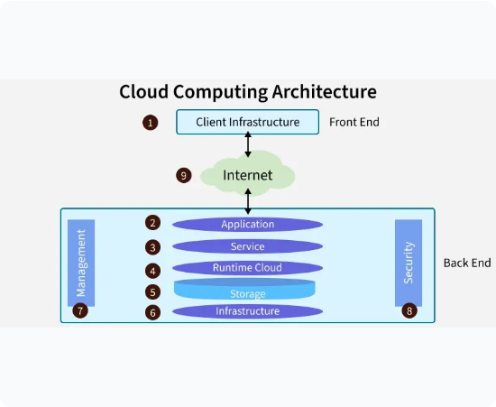
Day 1: SAP AI Landscape
The Big Picture
SAP's AI strategy relies on a "Side-by-Side" extensibility model. We keep the core clean (S/4HANA) and run AI workloads on BTP.
SAP AI Core: The execution engine. It runs your Docker containers and manages compute resources.
SAP AI Launchpad: The administration UI. Used to manage deployments, view logs, and configure connections.
HANA ML: In-database machine learning (distinct from AI Core).
❖ SAP AI Academy

Slide 4

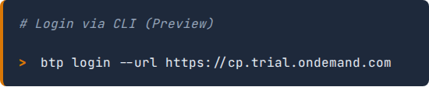
Day 1 Lab: Environment Setup
Why Cloud Foundry?
Your Checklist
While AI Core is Kubernetes-based, the BTP Trial often uses Cloud Foundry concepts for initial organizational structure and service instantiation.
Create Account: Sign up for SAP BTP Trial (Cockpit).
Global Account: Verify you have a Global Account (P-User).
Subaccount: Automatically created (usually called 'trial').
Enable Cloud Foundry: Turn on the CF environment in your subaccount to manage orgs/spaces.
❖ SAP AI Academy

Slide 5






Day 2: Entitlements & Plans
Entitlements are the "currency" of SAP BTP. Without assigning them to your subaccount, you cannot create service instances.
Entitlements
Service Plans
Instances
Rights to provision and consume a resource. Must be moved from Global Account to Subaccount.
Define the size/variant. E.g., free vs standard. For this course, strictly use free tier.
The actual instantiation of the service. You will create one instance for AI Core and one for Launchpad.
❖ SAP AI Academy

Slide 6


Day 2 Lab: Provisioning Services
Required Services
Navigate to Entity Assignments in your BTP Cockpit and add the following:
Service | Plan
sap-ai-core | free
sap-ai-launchpad | free
BTP Cockpit Interface
Tip: Use "free" plan, not "standard" to avoid costs.
❖ SAP AI Academy

Slide 7

Day 3: Containerization
Why Docker?
SAP AI Core is built on Kubernetes. It does not run raw Python scripts; it runs Containers.
Isolation: Your code and dependencies (scikit-learn, pandas) are packaged together.
Portability: "It works on my machine" means it works on AI Core.
Workflow: You will build images locally, push to Docker Hub, and AI Core will pull them.
❖ SAP AI Academy

Slide 8








Day 3 Lab: Local Toolset
Install the following tools to prepare your development environment:
Docker
VS Code
BTP CLI
Git
Desktop version for building images.
Recommended IDE + Python Ext.
Command line interface for SAP BTP.
For syncing templates to AI Core.
❖ SAP AI Academy

Slide 9

Day 4: Security
Authentication & Keys
SAP BTP uses OAuth 2.0. To allow external tools (like your laptop or Postman) to talk to AI Core, you need a Service Key.
The Service Key contains:
clientid
clientsecret
url (Auth URL)
service_url (API Endpoint)

Slide 10
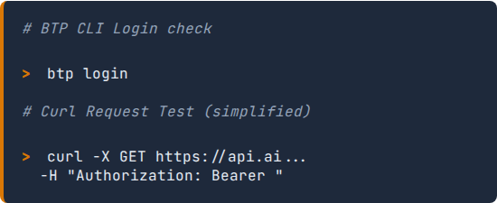
Day 4 Lab: Connectivity
Generate & Test
1.
Go to BTP Cockpit > Instances.
2.
Select your sap-ai-core instance.
3.
Click "Create Service Key".
4.
Copy the JSON output.
5.
Authenticate via CLI or Postman to verify access.
❖ SAP AI Academy

Slide 11
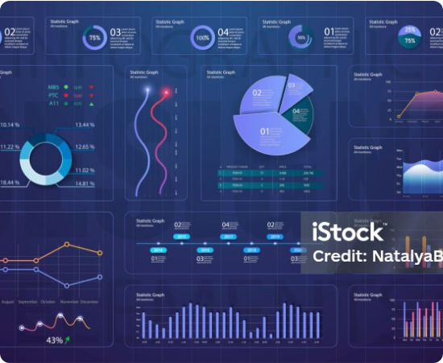
Day 5: AI Launchpad
The Command Center
SAP AI Launchpad is a SaaS application that provides a unified interface for all your AI runtimes.
Administration: Add connections to multiple AI Core instances.
Resource Groups: Logical isolation (e.g., Dev, Test, Prod) within one AI Core instance.
Operations: Monitor training metrics and deployment status.
❖ SAP AI Academy

Slide 12




Day 5 Lab: Final Config
Week 1 Complete!
You have successfully subscribed to the Launchpad, connected it to your AI Core instance using the Service Key, and created your first Resource Group (default).
Next Week: AI Core Operations (Argo Workflows & Training)
❖ SAP AI Academy

Slide 13




Image Sources
https://media.geeksforgeeks.org/wp-content/uploads/20250825133452766889/cloud_computing_architecture.webp
Source: www.geeksforgeeks.org
https://www.apiculus.com/blog/wp-content/uploads/2025/02/Blog-Cover.png
Source: www.apiculus.com
https://travisasm.com/web/image/12500-71b7a47c/APILEAKS%20ART.jpeg?access_token=f3def6ce-cd63-4d19-9f10-60b805a321c8
Source: travisasm.com
https://media.istockphoto.com/id/1145433490/vector/infographic-dashboard-template-with-flat-design-graphs-and-pie-charts-online-statistics-and.jpg?s=1024x1024&w=is&k=20&c=VxenDRSF9dp8dPmHgI0KnYCPWWJ33D8mghCwKltpWAE=
Source: www.istockphoto.com

